Slide 1
RF-Protect: Privacy Against Device Free Wireless Sensing
Jay Shenoy
Zikun Liu, Bill Tao, Zach Kabelac, Deepak Vasisht

Slide 2
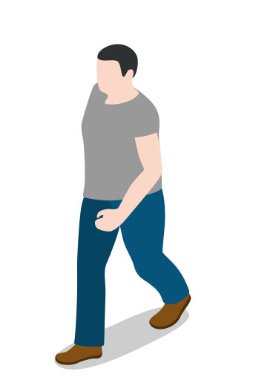
Breathing
Sleep
Emotion
Sensor

Slide 3
Wireless Sensing is Prevalent (Texas Instruments. Awr1642, Chokkatu Wired 2022 )

Slide 4
Heart
Rate
Sleep
Emotion
Sensor
Notes:
In the last few years, wireless sensing has become a tremendous tool in helping us monitor and analyze human motion. These sensors typically work by sending signals over the air and measuring the reflections from humans moving in the environment. What really interesting is that these sensors have become so sophisticated that they can measure even the smallest of human motions, allowing us to use them to gain access into a variety of health metrics based on human motion such as sleep, heartrate, and even emotion. Wireless signals can also travel in NLOS and through walls so all of this sensing can technically even be done even if the sensor is outside your house.

Slide 5
Imagine…
Burglar can detect when you’re away or sleeping
Amazon/Google can sell your data
Healthcare providers can price your plan based on tracking

Slide 6
What can we do?
RF Signals will Always Reflect!

Slide 7
RF Privacy Solutions are Limited (Yang et. Al 2013)
How do we ensure privacy?
Jamming
Faraday Cages

Slide 8
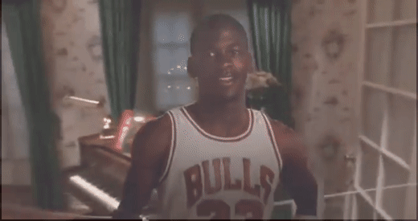
Privacy Example

Slide 9
RF-Protect: Injecting Ghosts against RF-Tracking

Slide 10
RF-Protect: Injecting Ghosts against RF-Tracking
RF-Protect

Slide 11
Q1: How do we generate moving reflections?
Q2: How do we make them move like a human?

Slide 12
RF-Protect: How does Indoor Radar-tracking work?
Track 2D Location
FMCW for Distance
Antenna Array for Angle
(Adib et. Al 2013, TI Awr1642 2020)
Frequency
$$Distance=C × \frac{ToF}{2}$$
$$ToF$$
Radar
Time

Slide 13
RF-Protect: Distance Spoofing
$${+ f}^{′}$$
$Distance=C × \frac{ToF}{2}= C ×\frac{Δf}{2 × slope}$
Frequency
$$Δf$$
$$ToF$$
Time
RF Switch

Slide 14
RF-Protect: Angle Spoofing
Physical Spread in Space
Room
Reflector

Slide 15
Q1: How do we generate moving reflections?
Q2: How do we make them move like a human?

Slide 16
Realistic Human Movements
Use Generative Adversarial Network

Slide 17
RF-Protect: Trajectory Generation
Goal: Distribution of fake trajectory must match human trajectory
Traditional GANs suffer from modal collapse
Cannot output diverse set of synthetic trajectories

Slide 18
RF-Protect: Trajectory Generation

Slide 19
RF Protect: Privacy Scenarios
Scenario: Occupant Detection
RF-Protect: Can always fake humans
Scenario: Occupant counting
RF-Protect: Spoof multiple ghosts
Scenario: Adversary wants to detect private health metrics
RF-Protect: Ghosts can "breathe"

Slide 20
RF Protect: Evaluation

Slide 21
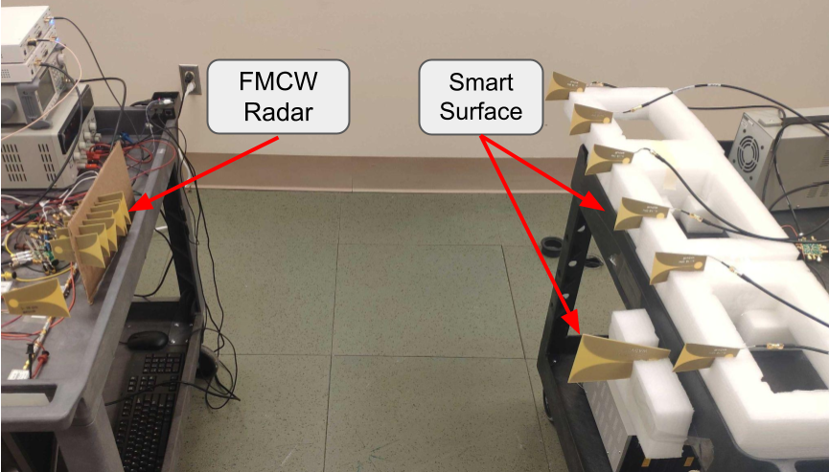
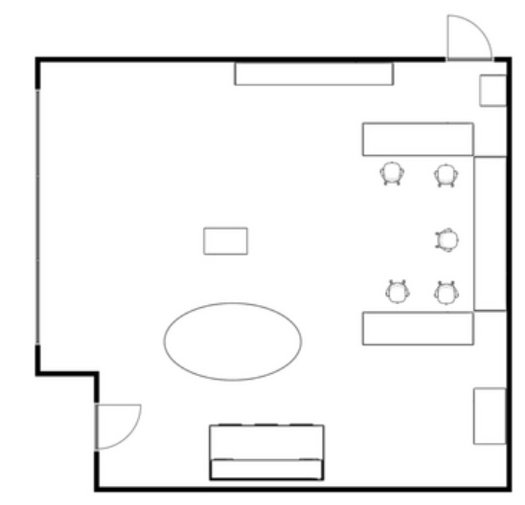
Experimental Setup
Standard FMCW Radar
Operates in 6-7 GHz
Post-Processing Algorithms
Experimented across two indoor environments in NLOS
45 Trajectories per Environment
10m
15.24m
6.6 m
Home
Office
7.62m

Slide 22
RF-Protect: Example

Slide 23
RF-Protect: Spoofing Error
Median Spoofing Error:
12.70 cm (Home)
24.49 cm (Office)

Slide 24
Evaluation: Trajectory Generation
3.44
30 Person Qualitative Survey
1.87
2.02
1.23
1

Slide 25
RF Protect: Breathing

Slide 26
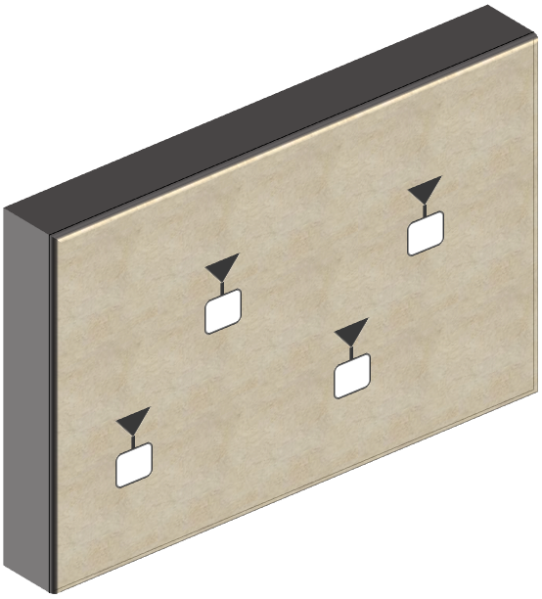
Conclusion
RF-Protect proposes a novel privacy mechanism against wireless sensing
Opportunities for future work:
3D Spoofing
Imaging Spoof
We envision RF-Protect can become a vital part of smart surfaces
Check out our code and experimental datasets at:
https://github.com/ConnectedSystemsLab/rf-protect

